Slide 1
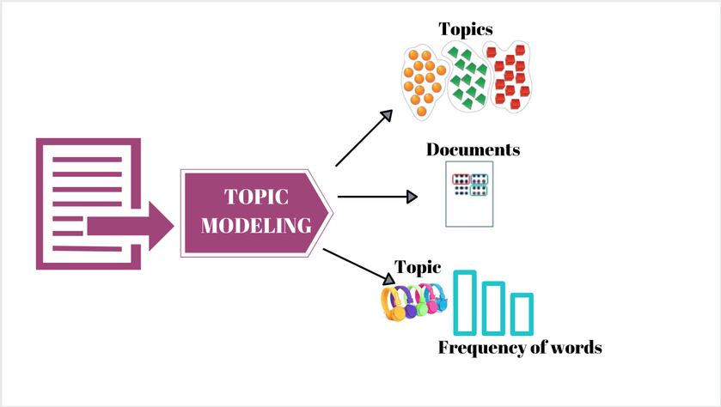
Topic Modeling:
WeFour:
Thanmai Gottumukkala
Ravalika Kummari
Vijayalakshmi Atluri
Yuvraj Boyilla

Slide 2
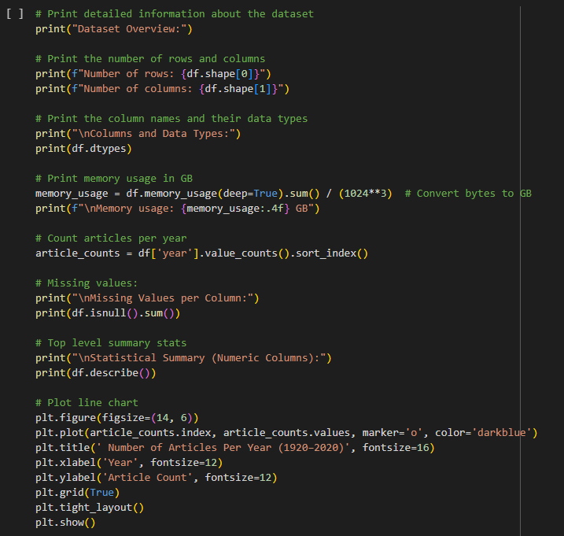
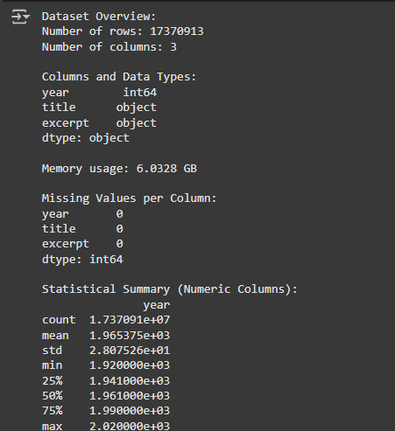
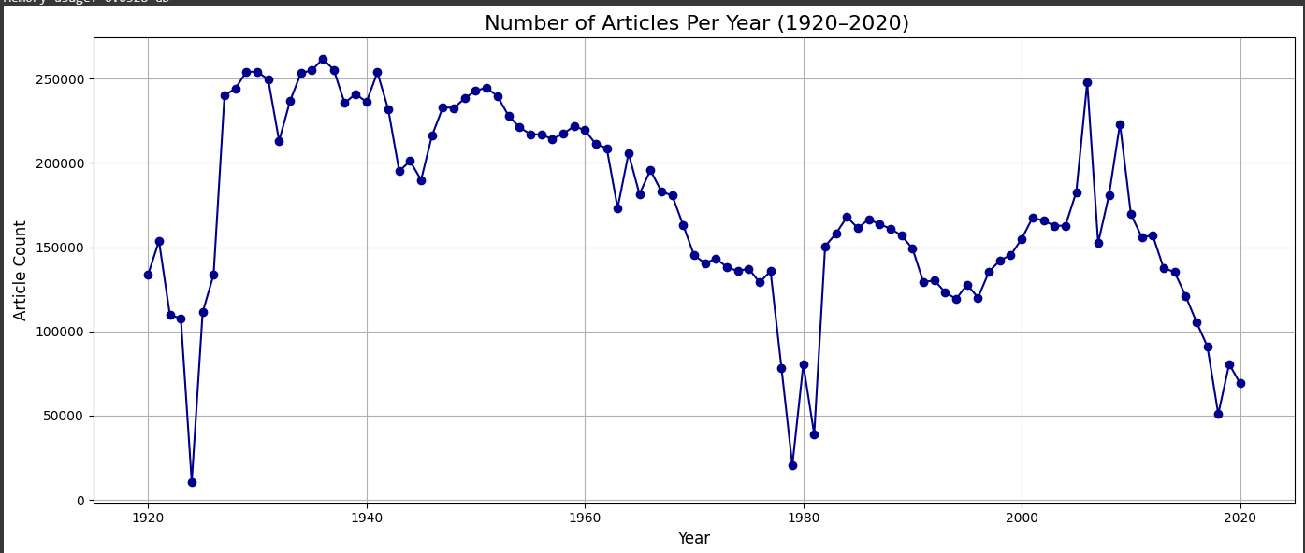
Dataset Overview
We started with a basic exploration of the dataset by checking its shape, column types, memory usage, and missing values. Summary statistics gave insight into numeric data, and a line chart of article counts from 1920 to 2020 revealed clear trends in publication volume over time.

Slide 3
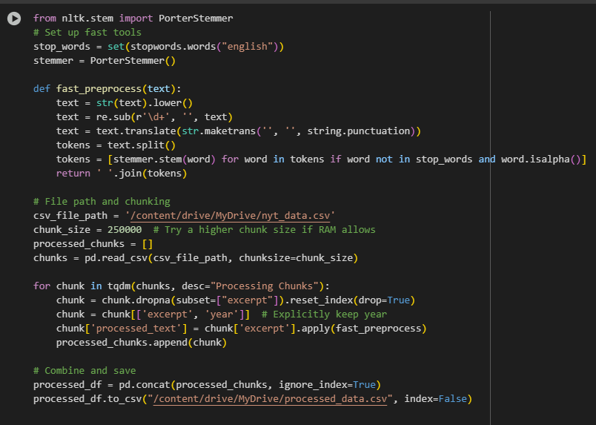
Data Preprocessing
We performed efficient text preprocessing using NLTK’s stopword removal and stemming. Specifically, we implemented a fast_preprocess() function, to clean and tokenize text by lowering case, removing digits and punctuation, removing stopwords, and stemming. To account for the size of the data we processed the data in chunks of 250,000 rows. For each chunk we clean and then retain only the relevant columns (excerpt and year). The cleaned chunks are then combined and saved as a new CSV file for downstream analysis.

Slide 4
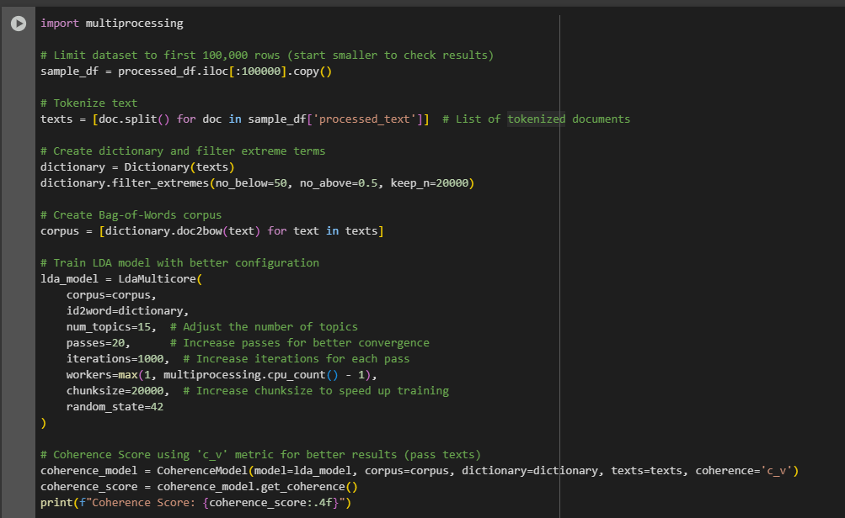
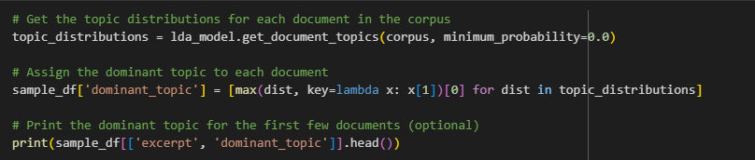
Model Analysis:
Latent Dirichlet Allocation
We picked a sample of 100,000 already pre-processed articles, after which we tokenized the articles to create a dictionary and a Bag-of-Words corpus, removing too rarified or over common vocabulary. We used Gensim's LdaMulticore to create a 15-topic LDA model utilizing optimal settings to achieve performance and optimal coherence. We evaluated the LDA model with the c_v coherence score and assigned each document a dominant and unique topic based on topic probability for further analysis.

Slide 5
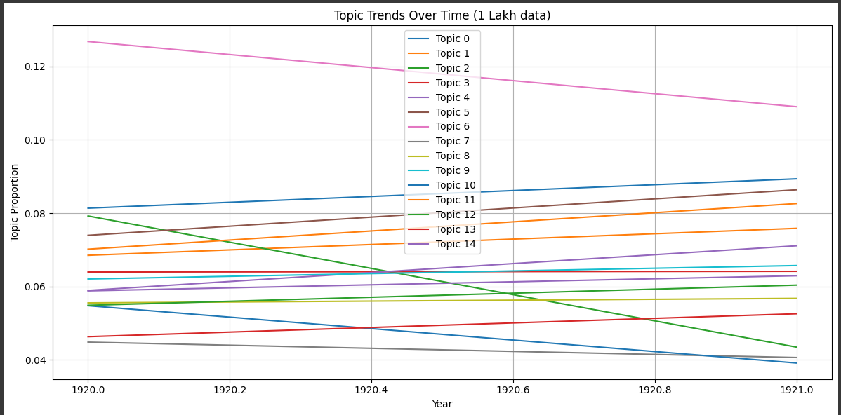
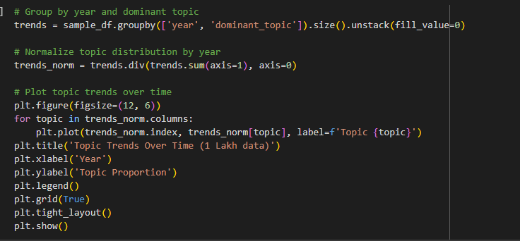
Topic Trends
We grouped articles by year and dominant topic, normalized the topic distribution per year, and plotted a line chart to visually display the evolution of proportions of different topics over time.

Slide 6
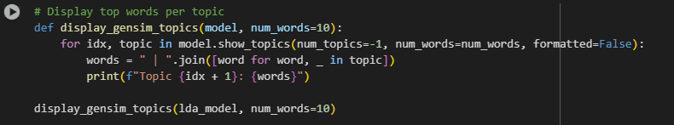
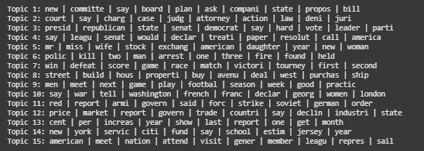
Top Keywords
We extracted and displayed the top 10 keywords for each topic from the trained LDA model to interpret and label the topics based on their most representative terms.

Slide 7
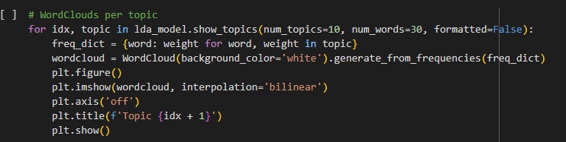
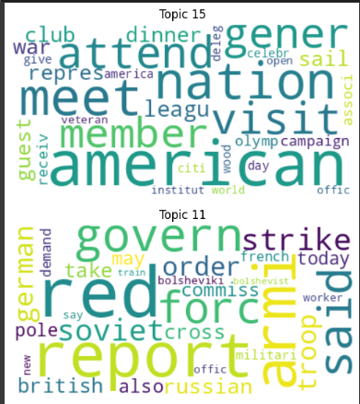
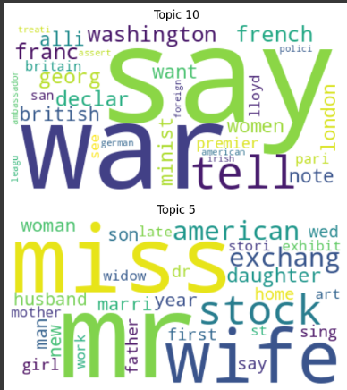
Topic Wordclouds
We generated word clouds for each topic using the top 30 keywords, providing a visual representation of the most prominent terms associated with each topic for easier interpretation.

Slide 8
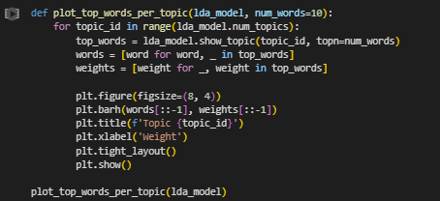
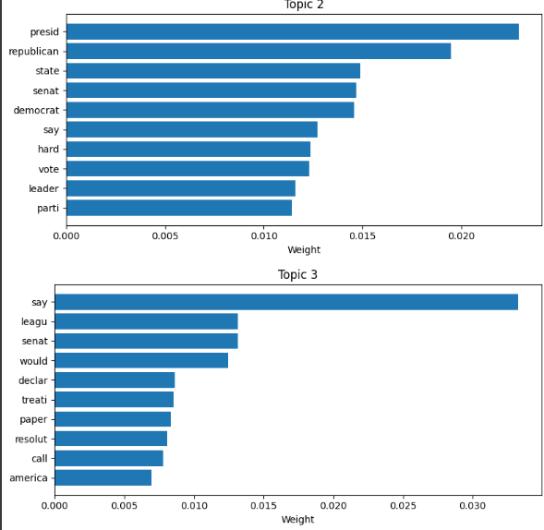
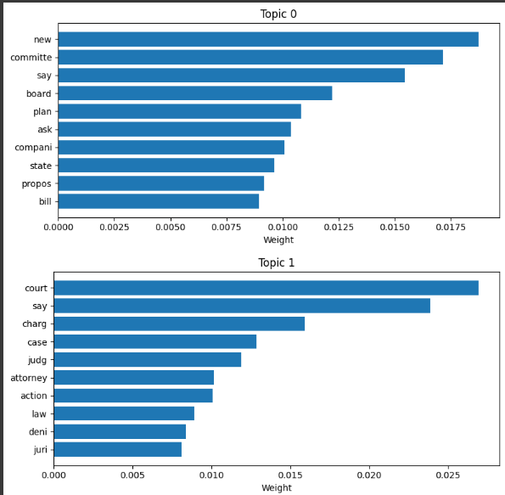
Topic Bar Charts
We created horizontal bar charts to visualize the top 10 words for each topic generated by the LDA model. For each topic, we retrieved the top words along with their weights and plotted them. The bar charts help us easily identify the most influential terms for each topic, with the word weight on the x-axis and the words listed on the y-axis, allowing for a clear comparison of word importance within each topic.

Slide 9
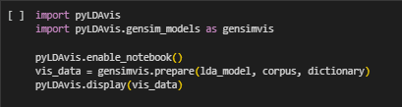
We used pyLDAvis to generate a visual interactive exploration of the LDA model so that we could visually exploit the topics of our model in a more intuitive manner. The visual maintains or shows the relationships between topics, the relative sizes of circles represent topic prevalence, and the proximity between topics refers to similarity. This allowed for a more interactive and precise exploration of both topic dispersion and coherence in the data.
Interactive Visualization

Slide 10
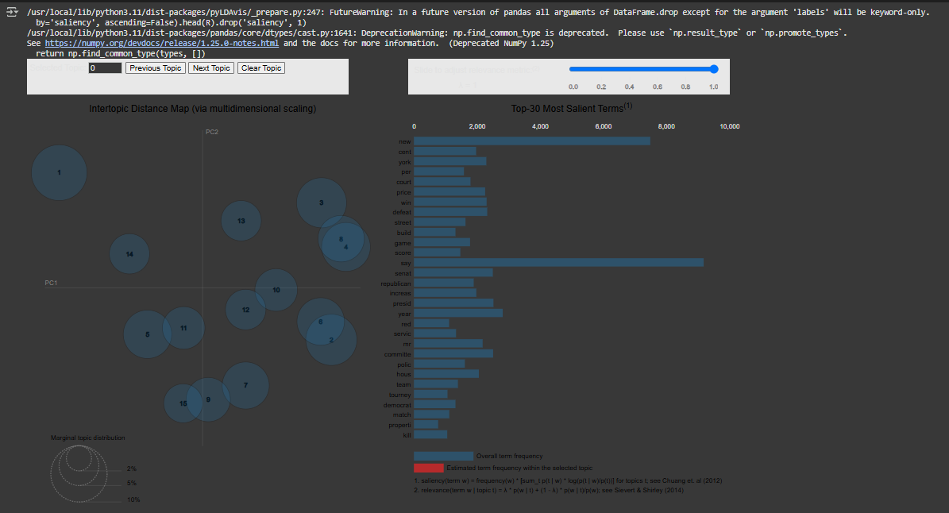
Visualization

Slide 11
Contribution
Thanmai Gottumukkala: Handled dataset loading, chunk-wise reading, and efficient text preprocessing using NLTK and custom functions for large-scale processing.
Ravalika Kummari: Led the LDA model training using Gensim with optimized hyperparameters and performed topic interpretation and coherence analysis.
Vijayalakshmi Atluri: Focused on model visualization using word clouds, bar charts, and interactive tools like pyLDAvis to make topic insights more interpretable.
Yuvraj Boyilla: Conducted initial data exploration, generated article trend visualizations, and actively contributed to troubleshooting and debugging throughout the project.

